Slide 1

Range-Based For Loops
in C++
Clean, Efficient Iteration Introduced in C++11
C++11
Modern C++
STL

Slide 2








What Are Range-Based For Loops
C++11 Feature
Traditional For Loop
Cleaner iteration syntax
for (auto it = vec.begin(); it != vec.end(); ++it) {
auto& elem = *it;
Less Boilerplate
// process element
No manual index or iterator management
}
Less Error-Prone
Range-Based For Loop
Eliminates off-by-one and other loop errors
for (auto& elem : vec) {
More Readable
// process element
}
Clear intent: iterate over entire container
Generic
Key Difference
Works with any type providing begin()/end()
Range-based loops automatically handle iterator lifecycle, bounds checking, and element access

Slide 3





Basic Syntax
Syntax
Simple Example
std::vector<int> numbers = {1, 2, 3, 4, 5};
for (range_declaration : range_expression) {
for (int x : numbers) {
std::cout << x << ' ';
// loop body
}
}
// Output: 1 2 3 4 5
range_declaration
Automatically handles iteration
Variable representing each element
Works with any standard container
range_expression
Container or range to iterate over
Clean and expressive syntax

Slide 4


Iterating Over Standard Containers
std::deque
std::vector
std::deque<double> deq = {1.1, 2.2, 3.3};
std::vector<int> vec = {1, 2, 3, 4, 5};
for (const auto& d : deq) {
for (int x : vec) {
std::cout << d << ' ';
std::cout << x << ' ';
}
}
std::list
All STL containers supported
std::list<std::string> list = {"a", "b", "c"};
Works with user-defined types
for (const auto& s : list) {
std::cout << s << ' ';
Uses begin()/end() methods
}
Clean, readable syntax

Slide 5





Iterating Over Associative Containers
std::map
Ordered Containers
std::map<std::string, int> ages = {
std::map, std::set iterate in sorted order
{"Alice", 30}, {"Bob", 25}
};
for (const auto& [name, age] : ages) {
Unordered Containers
std::cout << name << ": " << age << '\n';
std::unordered_map: undefined iteration order
}
Structured Bindings (C++17)
std::set
[key, value] syntax for map pairs
std::set<int> unique = {5, 3, 5, 1, 2};
std::unordered_map
for (int x : unique) {
std::cout << x << ' ';
for (const auto& [k, v] : umap) {
}
// Process key-value pair
}
// Output: 1 2 3 5 (sorted)

Slide 6



Iterating Over Arrays
Works with Both Types
C-Style Array
C-style arrays and std::array supported
int arr[] = {1, 2, 3, 4, 5};
No Manual Size Handling
for (int x : arr) {
std::cout << x << ' ';
Array size automatically determined
}
Bounds Safe
std::array
Prevents out-of-bounds access
std::array<int, 3> std_arr = {10, 20, 30};
Array Decay Handled
Works even when arrays decay to pointers
for (const auto& x : std_arr) {
std::cout << x << ' ';
}
Performance Note
Range-based for loops are as fast as traditional iterator-based loops with modern compilers

Slide 7
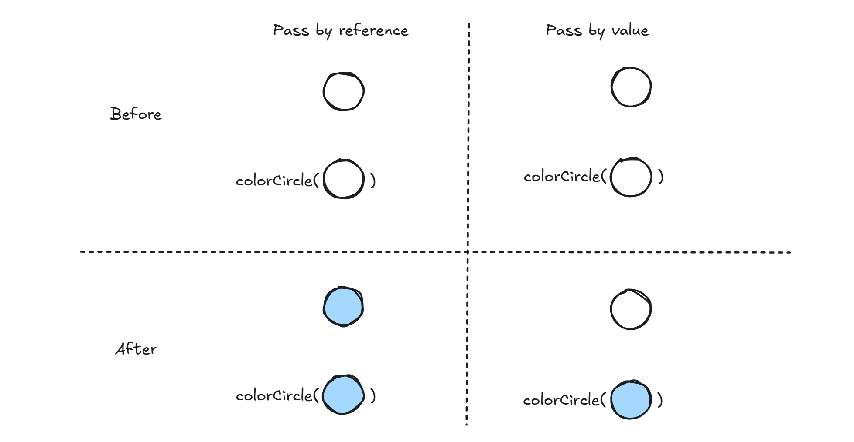


Using References
const T& - Read-Only
std::vector<std::string> names = {"Alice", "Bob"};
for (const auto& name : names) {
std::cout << name << ' ';
}
Avoid unnecessary copies - reference is faster
T& - Modification
for (auto& name : names) {
Essential for large objects (strings, vectors)
name = "Hello " + name;
}
const& ensures element cannot be modified
Non-const& allows in-place modification

Slide 8



Using Auto
Reduces Verbosity
Simplify Complex Types
No need to write complex type names
std::map<std::string, std::vector<int>> data;
Prevents Type Errors
for (const auto& [key, values] : data) {
Compiler deduces correct type automatically
// Clean and readable
}
Easier Maintenance
Less Verbose Code
Type changes automatically update
std::vector<std::complex<double>> nums;
Works with Templates
for (const auto& num : nums) {
Essential for generic code
// Much shorter than explicit type
}
Best Practice
Use const auto& for read-only access to avoid copies

Slide 9





Range-Based Loops with Custom Types
Requirements
Iterator Requirements
Member Functions
Must satisfy InputIterator concept
begin() and end() methods
Support prefix increment (++it)
Free Functions
ADL: begin(obj) and end(obj)
Support dereferencing (*it)
class MyContainer {
Support comparison (it != end)
public:
int* begin();
int* end();
Common Pattern
};
Custom containers typically hold an underlying standard container
for (int x : container) {
std::cout << x << ' ';
}
Note: C++20 introduces ranges library for more flexible iteration

Slide 10


Common Pitfalls
Modifying During Iteration
Lifetime Issues
Undefined Behavior!
Container May Be Destroyed
for (auto x : vec) {
auto& ref = get_temp_container();
vec.push_back(x); // Don't do this!
for (auto x : ref) { }
}
// Container may be destroyed
auto vs auto& Confusion
Forgetting const
Performance Impact
Accidental Modification
for (auto x : big_vec) { }
for (auto& s : strings) {
// Copies every element!
s = ""; // Accidental!
for (auto& x : big_vec) { }
}
Best Practice
Always use const auto& for read-only access to avoid copies and prevent accidental modifications

Slide 11




Performance Considerations
Performance Impact
Copy vs Reference
std::vector<std::string> vec(10000, "large string");
✓ for (const auto& x : vec) {}
// No copies - Fast!
✗ for (auto x : vec) {}
// Copies 10000 strings - Slow!
Modern compilers optimize reference overhead for small types
Move semantics with std::move for transfer semantics
Use const auto& by Default
Safest and fastest for most types
Large objects: always use references to avoid copies
Compiler optimization: Modern compilers optimize away reference overhead for small types like int

Slide 12






C++20 Ranges Integration
Filter Views
auto filtered = data | std::views::filter(is_even);
for (auto x : filtered) {
std::cout << x << ' ';
}
Transform Views
Composability
Combine operations with pipe operator (|)
auto transformed = data | std::views::transform(square);
Lazy Evaluation
for (auto x : transformed) {
Processing occurs only when needed
std::cout << x << ' ';
}
Zero-Cost Abstraction
No temporary allocations
auto chain = data | std::views::filter(is_even)
| std::views::transform(square);
Common Ranges
for (auto x : chain) { }
views::filter, views::transform, views::take, views::drop

Slide 13









Best Practices & Examples
Use Range-Based For
Core Best Practices
Iterating entire container
Use const auto& by Default
Avoids copies, prevents accidental modification
Simple iteration pattern
Use auto& for Modification
Explicit intent to modify elements
Read-only or modify-in-place
Never modify container during iteration
Use Traditional For
Consider performance for large objects
Need index access
Need iterator for advanced operations
Bottom Line
Range-based for loops make code cleaner, safer, and more maintainable. Use them whenever you need to iterate over an entire container.
Modifying container size

Slide 14







User-Defined Data Structures
Custom Traversal Patterns
Row-Major
Left to right, top to bottom
Custom Matrix Container
Column-Major
class Matrix {
Top to bottom, left to right
std::vector<int> data;
size_t rows, cols;
Diagonal Traversal
public:
Custom access patterns
auto begin() { return data.begin(); }
auto end() { return data.end(); }
};
Iterator Adapters
Reverse, filtered views
Matrix m(3, 3);
for (int x : m) {
std::cout << x << ' ';
Nested Containers
}
Multiple levels of iteration
Key Insight
Custom iterators enable advanced traversal while maintaining range-based for syntax

Slide 15





Iterating Struct Members and User Types
User-Defined Type
C++17: Structured Bindings
struct Person {
std::string name;
for (const auto& [name, age] : people) {
int age;
std::cout << name << ": " << age << '\n';
};
}
std::vector
{"Alice", 30},
{"Bob", 25}
C++23: std::for_each Member
};
Native reflection for iterating struct members
Direct Member Access
Clean member extraction syntax
for (const auto& p : people) {
Type-safe and readable
std::cout << p.name << ": " << p.age << '\n';
}

Slide 16







Custom Iterators for User Types
Iterator Requirements
Implementation Strategy
Prefix Increment
Iterator& operator++()
Hold Pointer
Iterator stores position
Dereference
T& operator*()
Return Reference
Dereference returns T&
Comparison
bool operator!=(Iterator&)
Return *this
Chain increment calls
class Iterator {
int* ptr;
Best Practices
public:
• Use std::iterator_traits for standard interface
int& operator*() { return *ptr; }
• Mark iterator category (e.g., std::input_iterator_tag)
Iterator& operator++() { ++ptr; return *this; }
bool operator!=(const Iterator& other) { return ptr != other.ptr; }
• Support all InputIterator operations
• Consider C++20 concepts for type safety
};

Slide 17






Advanced Patterns Summary
Custom Containers
Custom Iterators
Structured Bindings
begin()/end() methods
Complex data structures
C++17 feature
Quick integration with range-based for loops
Implement iterator interface manually
Clean member access syntax
Enum Iteration
Ranges Integration
Initializer lists / C++23
C++20 library
Use {values} or std::for_each
Views and algorithms support
Standard Containers
Custom Data Structures
Complex Traversal
Use Built-in Support
Implement begin()/end()
Custom Iterators
Final Recommendations
Prefer standard containers when possible
Implement custom iterators only when necessary
Leverage C++17/20 features
Use const auto& by default
Consider ranges for composition
Follow iterator best practices

